Slide 1



Product Release Plan

Slide 2

Definitions/Acronyms:
Term/Acronym | Definition
A-SPICE | Automotive Software Process Improvement and Capability Determination
SYS | System Engineering
SWE | Software Engineering
Workflow | Definition, execution and automation of business processes where tasks, information or documents are passed from one participant to another for action, according to a set of procedural rules.
Trace | Link between two meaningful contents in a document

Slide 3
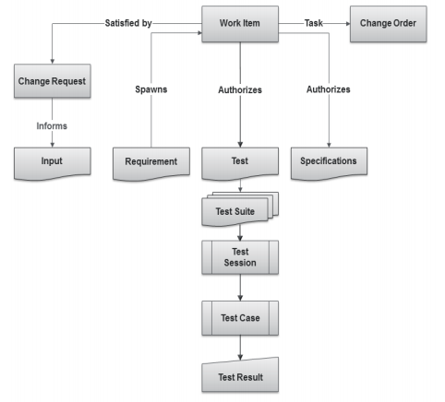
What Are Items?
  Items are the basic building blocks of the Integrity data model, and represent the information assets and process objects associated with software development.
  For example, items can represent Work items, projects, requirements, test cases, change requests, and defects.
  Every item is configurable and contains metadata and history about that item.
  Every item type has its own enforceable workflow which describes how it moves from state to state, complete with definable rules, full audit trails, and security.
  Escalations, conditional assignments, notifications, and external processes can all be defined and initiated as part of Integrity’s process automation

Slide 4
Creating a Product Release Plan

Slide 5
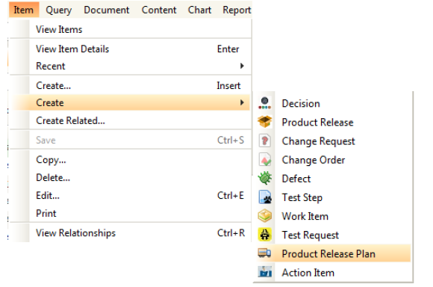
Creating Product Release Plan
Select Create Item menu to create a new Product Release Plan Item in Integrity.
Steps:
1.Creating Product Release Plan
2.Editing data in Item view
3.Applying changes in created item
4.Item Details View
5.Product Release Plan Workflow

Slide 6
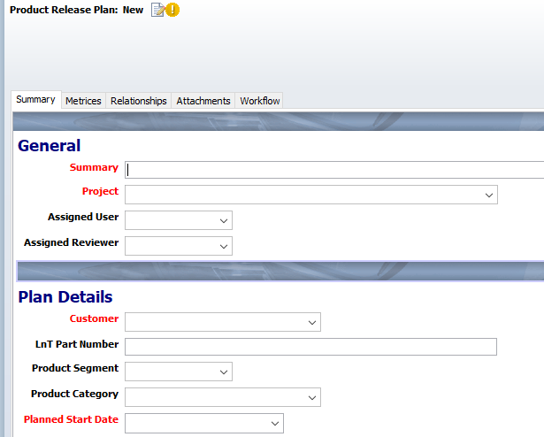
Creating Product Release Plan
Item details view will open up. Enter or select correct values for the fields present. Enter values in all fields. Mandatory fields are marked Red.
Steps:
1.Creating Product Release Plan
2.Editing data in Item view
3.Applying changes in created item
4.Item Details View
5.Product Release Plan Workflow

Slide 7
Creating Product Release Plan
All other fields visible in the Item Details view must be filled.
Clicking on “Apply” will keep the user on the same screen while clicking on “OK” will show the user a non-editable form-like view.
Clicking “Apply” will save the document. Alternately “Ctrl + S” can also be used.
Click on “OK” to finish creating.
Steps:
1.Creating Product Release Plan
2.Editing data in Item view
3.Applying changes in created item
4.Item Details View
5.Product Release Plan Workflow

Slide 8
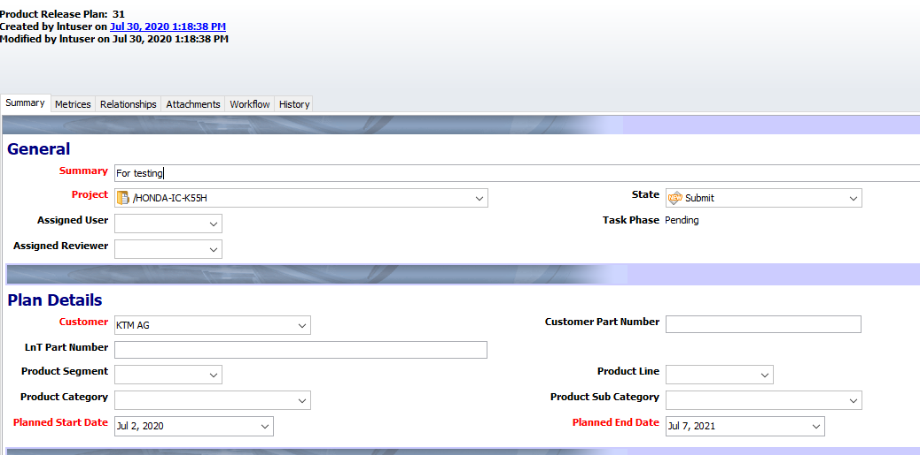
Creating Product Release Plan
Once user clicks on “Apply”, the Item Details view will appear as follows:
Steps:
1.Creating Product Release Plan
2.Editing data in Item view
3.Applying changes in created item
4.Item Details View
5.Product Release Plan Workflow

Slide 9
Creating Product Release Plan
The workflow will be as follows:
Steps:
1.Creating Product Release Plan
2.Editing data in Item view
3.Applying changes in created item
4.Item Details View
5.Product Release Workflow Plan

Slide 10
Product Release Plan –Details Tab
The Details tab contains the following sections:
General Section
Plan Details Section
General Section consists of the following fields:
Summary: Short Title for the Product Release
Project: Project for which the Product Release will take place
State: State of the item based on workflow. (Default state selected will be “Submit”)
Assigned User: User responsible for the plan
Assigned Reviewer: User responsible to monitor and examine the Plan

Slide 11
Product Release Plan –Details Tab
Plan Details Section consists of the following fields:
Customer: Select name of the customer from dropdown.
Customer Part Number: Unique part number given by customer.
Company Part Number: Unique part number of the Company.
Product Segment: Chose form dropdown list (2 wheeler, 3 wheeler, 4 wheeler, etc.)
Product Line: Chose from the list of products
Product Category: Category of the product to be released.
Product Sub Category: Sub category of selected category (Based of category; sub-category values will change)
Planned Start Date: Beginning date of Product Release Plan
Planned Start Date: Finish date of Product Release Plan
Plan Matrix : Describe the proposed matrix for Product Release
Remarks: To be filled before the plan is cancelled or completed.
Product Releases: Product Release item associated with this plan should be attached here. (Click on “+” symbol and select from the list of options)

Slide 12
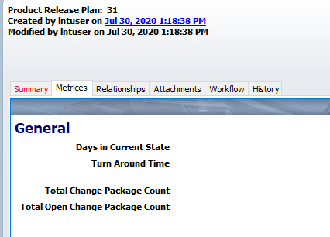
Product Release Plan–Metrics Tab
Metrics tab contains item metrics namely:
Days in Current State: Mentions number of days the item is in current state.
Turn Around Time: Mentions time to complete Workflow.
Total Change Package Count:
Total Open Change Package Count:

Slide 13
Product Release Plan –Relationships Tab
The Relationships tab include the following fields:
Product Release Plan For: User can attach Related item to this field for which the Product Release Plan is carried out.
Related item is Project.
Discussions: User can attach Discussions to this field related to the product release plan.
.

Slide 14
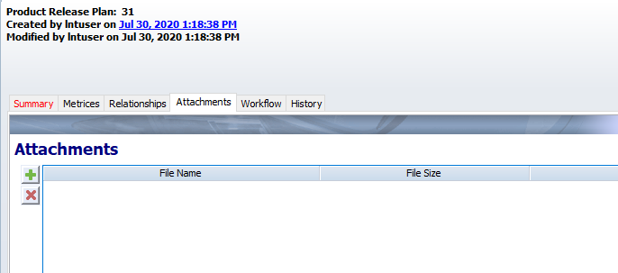
Product Release Plan –Attachments Tab
Attachment tab avails users to add project/document related files to the Product Release Plan.
Note: Attachments can be of any file format. It should not exceed the size of 5MB.

Slide 15
Managing Product Release Plan

Slide 16
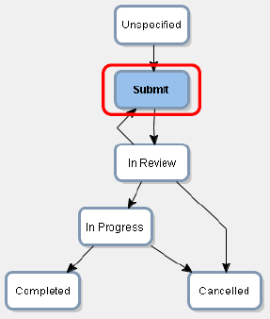
Managing Product Release Plan
Once the Product Release Plan is submitted, the Assigned User is responsible to change the state to In Review.
Follow the below steps:
  Edit the required Product Release Plan by right clicking and select “Edit Item”.
  Change the state of the Product Release Plan from Submit to In Review.
  Changing the state to In Review will make the following fields mandatory before applying changes.
    Assigned User
    Assigned Reviewer
    All Product Related Details
  Fill the mandatory fields and click on “Apply” button.
Who can edit:
Creator

Slide 17
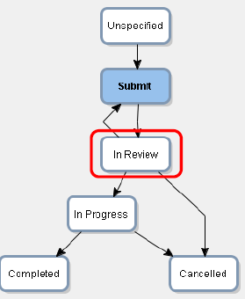
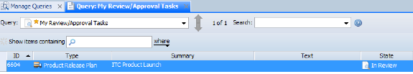
Managing Product Release Plan
Assigned Reviewer will get his review task in “My Review/Approval Tasks”.
Follow the steps:
  Go to Manage Queries.
  Search for “My Review/Approval Tasks”.
  The Review task will appear on the screen.
  Right on the task and select “Edit Item” to work on this task.
  Note: Only Assigned Reviewer will be able to edit and manage this item.
Who can edit:
Assigned Reviewer

Slide 18
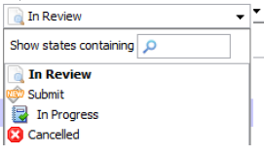
Managing Product Release Plan
Once the Product Release Plan is reviewed, the Assigned Reviewer is responsible to change the state to In Progress.
Follow the below steps:
  Edit the required Product Release Plan by right clicking and select “Edit Item”.
  If any modifications are required, Reviewer can change the state back to “Submit”.
  If alright, change the state of the Product Release Plan to In Progress.
  If the plan is cancelled by any chance, Reviewer can change the state to “Cancelled”.
  Fill the mandatory fields and click on “Apply” button.
  Note: Only Assigned Reviewer will be able to edit and manage this item.
Who can edit:
Assigned Reviewer

Slide 19
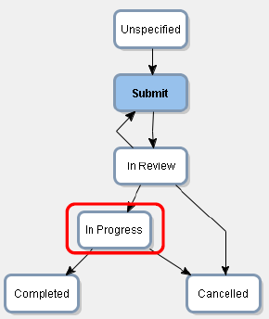
Managing Product Release Plan
Once the Product Release Plan is reviewed, Assigned Reviewer must take decision regarding the Plan and set the state accordingly.
Follow the below steps:
  Edit the required Product Release Plan by right clicking and select “Edit Item”.
  If the plan is cancelled by any chance, user can change the state to “Cancelled”.
  If alright, change the state of the Product Release Plan to Completed.
  Remarks field will become mandatory. Write Remarks regarding the plan completion.
  Fill the mandatory fields and click on “Apply” button.
  Note: Only Assigned Reviewer will be able to edit and manage this item.
Who can edit:
Assigned Reviewer

Slide 20

Thank you
Thank you

